Slide 1


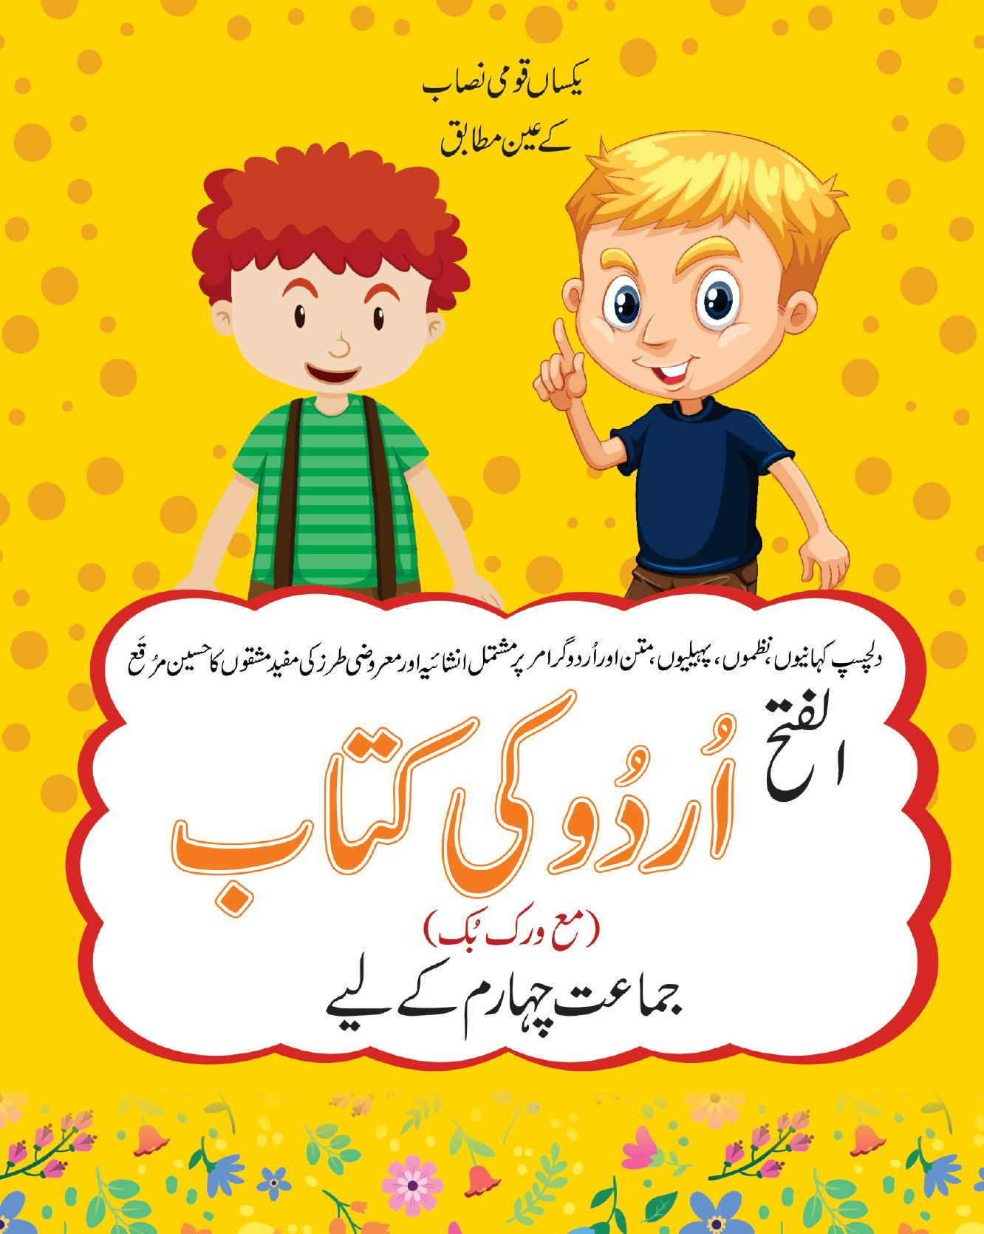
Urdu — الفتح اردو کی کتاب
Grade 4
A curriculum textbook from the Alfatah Series.
A Project of Azhar Publishers

Slide 2
i
What's Inside
Urdu — الفتح اردو کی کتاب • Grade 4
1
Urdu reading passages and stories
2
New vocabulary with word meanings
3
Grammar (قواعد): nouns, verbs and tenses
4
Comprehension questions and exercises
5
Handwriting and guided composition
6
Poems (نظم) with recitation

Slide 3
★
Purpose & What You Get
Builds Urdu reading, writing, grammar and comprehension for Grade 4, aligned to the Single National Curriculum.
“
Every book comes with
1
2
Interactive Digital Version
Page-Turn Flipbook
A book-level interactive activity set drawn from the book's content for engaging, screen-based practice.
A digital flipbook e-sample of the full book that opens from the right and turns like the real book.
A Project of Azhar Publishers • Alfatah Series

